Slide 1
Advanced Microbial Processes
Notes:
Refactoring refers to the rewriting of computer code to improve it by altering its internal structure without changing its external behavior. In the context of biology, this means altering a set of genes without disrupting their original function. Two scenarios are often encountered. One is genome refactoring. Here, a genome of an organism is rewritten to introduce convenient cloning sites for further investigation, or for defining the minimal set of genes for that organism. Such work has been carried out with phage T7, the Mycobacterium genome, and Yeast chromosomes. The other context is refactoring of genetic devices often as a prelude to transferring those genes into another organism.

Slide 2
Transfer of Gas Vesicles
PMID 9573198
Notes:
The transfer of large clusters of genes from one organism to the next is often quite challenging even when the phylogenetic distance between the organisms is very small. However, there are many examples of gene clusters that are modular and can be transferred without a refactoring effort.

Slide 3
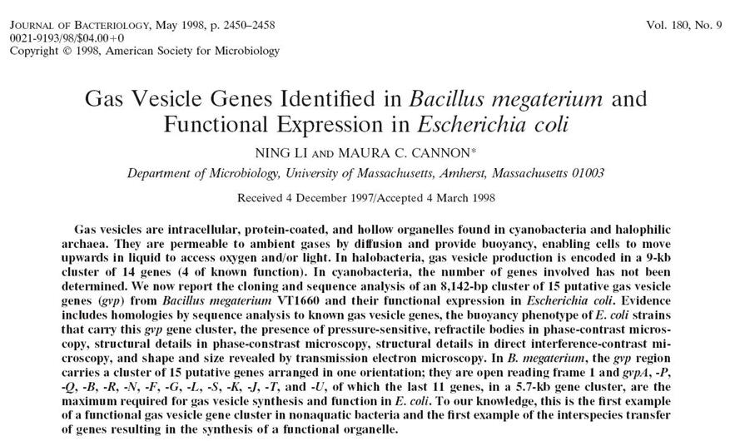
Notes:
In this study, Cannon and coworkers identify gas vesicle genes from a gram positive bacterium Bacillus megaterium, and functionally transfer the entire gene cassette to E. coli.

Slide 4
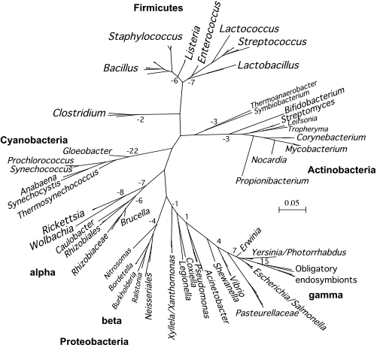
Genes in Bacillus megaterium
B. megaterium
E. coli
Notes:
The Bacilli and E. coli are about as far apart as you can get on the phylogenetic tree while staying within the prokaryotic kingdom. Thus, it is somewhat surprising that these genes transfer. Often the difficulties in transferring clusters of genes are regulation problems or caused by the inability of the recipient organism to express atypically large proteins. When the biochemistry of the cluster is fairly simple, and it does not involve extensive internal regulation, turning a foreign gene cluster into a microbiological device is quite easy.

Slide 5
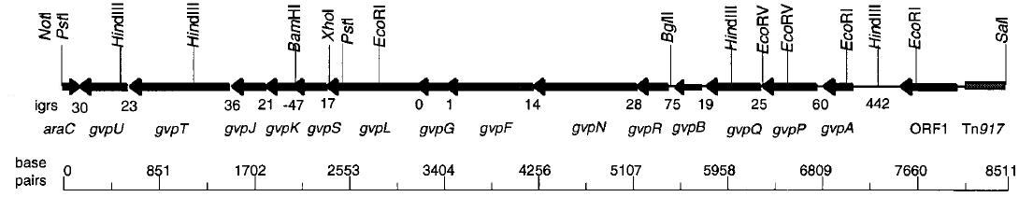
Genes in Bacillus megaterium
Gas vesicles are intracellular, protein-coated, and hollow organelles permeable to ambient gases
B. megaterium has a gene cluster encoding 8,142-bp cluster of 15 putative gas vesicle genes
“Open reading frames (ORFs) with homologies to gvp genes were identified in B. megaterium VT1660 in the course of a screening of Tn917-LTV1 transposon banks for polyhydroxyalkanoic acid mutants. One polyhydroxyalkanoic acid-overproducing mutant had the transposon inserted at a site contiguous with the gvp genes”
B. megaterium itself doesn’t make gas vesicles !!!
Notes:
Gas vesicles are intracellular, protein-coated, and hollow organelles permeable to ambient gases
B. megaterium has a gene cluster encoding an 8,142-bp cluster encoding 15 putative gas vesicle genes
The authors identified the gene cluster while doing transposon mutagenesis on megaterium. Megaterium is a polyhydroxyalkanoic acid over-producing strain, and extensive biotechnology work has been done since the 1980’s to produce PHAs as a sustainable plastic material, and indeed there are companies that produce the product. In one of their hits, the transposon had inserted at a site next to these gas vesicle genes, so they decided to clone out the genes and examine what they did.
Interestingly, B. megaterium itself doesn’t make gas vesicles, but when they move the genes into E. coli…

Slide 6
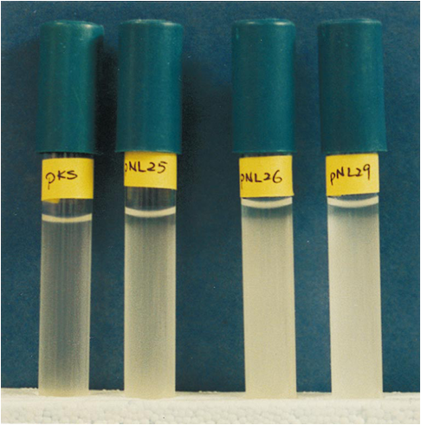
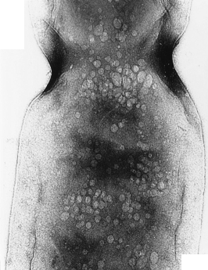
Gas vesicles in E. coli
Notes:
They get production of gas vesicles. When you examine the bacteria by TEM, you can see the little vesicles. At right you are looking at a bacterium zoomed in. At the top of the image you can see the septa where the bacterium is dividing. The white bubbles are the vesicles. Phenotypically, these vesicles cause bacteria to float in their medium. If you allow an E. coli culture to sit on the benchtop without agitation, the bacteria will settle to the bottom of the tube. However, in the strains that contain gas vesicle genes, the bacteria stay afloat.

Slide 7
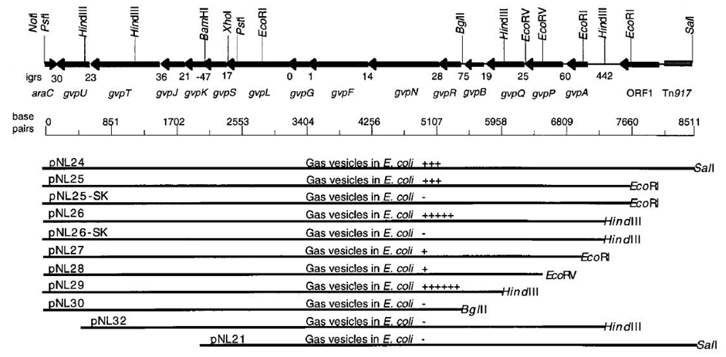
Deletion analysis
Only 11 of the 15 genes are sufficient to make vesicles
No internal deletions analyzed, but other pubs suggest that only 8 of these genes are sufficient for production of vesicles in E. coli
Very little is known about what the individual genes do
Notes:
They go on to dissect the gene cluster by examining truncations from the 5’ and 3’ end. From this, they can trim the device down to only 11 genes. Further studies have done more extensive analysis of this gene cluster systematically removing genes, and it turns out that only 8 of them are needed to produce vesicles in E. coli. Very little is known about what the individual genes do from a molecular function perspective, but that does not limit our ability to use this device as a functional actuator for making bacteria float. Indeed, this device has become quite popular within the iGEM competition.

Slide 8
Radiation-Induced Biofilms
Notes:
We’ve discussed in previous chapters how you can construct sensor, processor, and actuator devices and join them together to create complex devices.

Slide 9
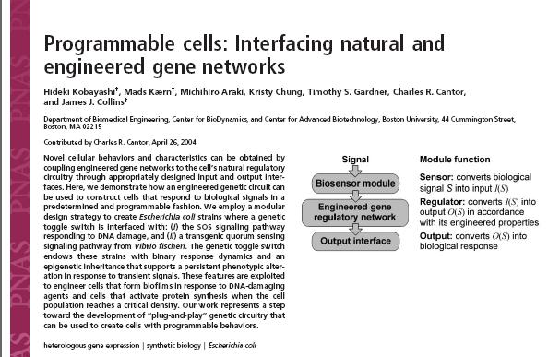
PMID 15159530
Notes:
In this study, Collins and coworkers construct a genetic circuit (the toggle switch) and use it to control a microbiological process (biofilm formation).

Slide 10
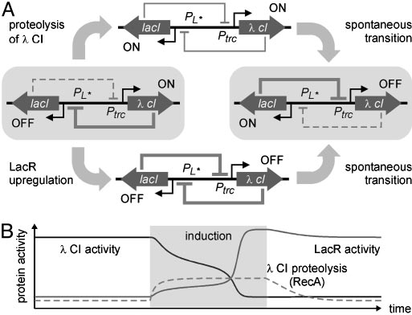
Radiation-Dependent Biofilms
Notes:
We’ve discussed the toggle switch before. It is the circuit that encodes two transcription factors that repress each others transcription. We also discussed that from a transcriptional control perspective, the toggle switch is a sensor. If you add the small molecule IPTG, you will deprepress lacI which will cause CI to dominate. When E. coli is irradiated with UV light or another source of DNA damage such as chemical mutagens, the CI protein is proteolytically cleaved inactivating it. Thus, irradiation with UV will flip the system towards lacI dominating.

Slide 11
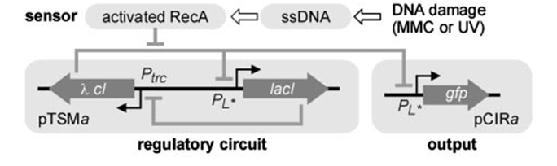
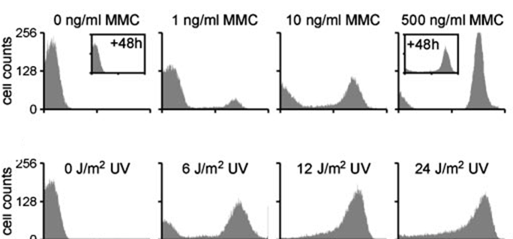
Radiation-Dependent Biofilms
Notes:
The specific transduction mechanism from DNA damage to proteolysis of CI involves the DNA repair machinery and recA activation. Suffice it to say, the induction of DNA damage derepresses PL promoters, so if you place GFP under PL in the system and induce damage, GFP turns on. Here they show cytometry data. Each chart is a histogram wherein the X axis is GFP fluorescense intensity, and the Y axis is cell counts. In the first row, they are examining the effect of 4 different concentrations of the mutagen MMC on the cells. With no mutagen, all the bacteria are white because cI is dominating. As damage is induced, the ‘all or none’ bistability of the circuit results in two populations of bacteria. At the highest concentration of mutagen, most of the cells join the ‘ON’ population. In the second row, a similar response is observed when UV light is used to create the DNA damage. Thus, they have a “dna damage sensor” that outputs transcription from PL and can be used to drive actuators.

Slide 12
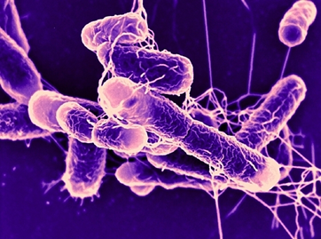
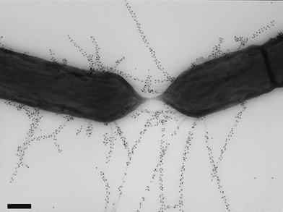
Biofilm formation in E. coli
PMID: 11473319
Notes:
The actuator in their system is biofilm formation. Many bacteria, including some E. coli, produce biofilms. Effectively biofilms are bacteria embedded in polysaccharide gel. As bacteria go, many produce more complex biofilms than E. coli, and they often start to look like developmental programs since the morphology of the film is well defined. In E. coli, though, biofilms are fairly simple. There is no internal order to the bacteria, just goo. The process for creating a biofilm is non trivial. Bacteria do not spontaneously adhere to one another, and thus surface modifications are required to initiate the process.
*
One critical component of biofilm formation in E. coli is an F pilus. Here you are looking at two E. coli participating in mating using their F pili. These pili are encoded on a 100kb plasmid called F plasmid which is in many strains of E. coli. MG1655 itself doesn’t have this plasmid, but it is present in many lab strains such as JM109. F plasmid is a conjugative plasmid. When two bacteria undergo mating with F, the F plasmid genome undergoes transfer in which it migrates through the channel of the F pilus into the recipient cell. In that cell, it resumes replication and production of new pili. Though it is not a virus (it’s a plasmid), it has the transmission behavior of a lysogenic phage.

Slide 13
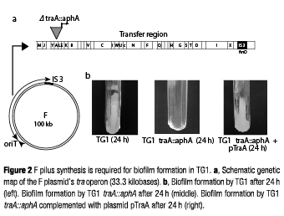
Biofilm formation in E. coli requires F plasmid
PMID: 11473319
Notes:
Like any process, if you knock out any one of the genes in F pilus formation the process is no longer observed. Earlier transposon studies have shown that knockout of the traA gene eliminates F pilus formation, and without the F pilus it also disrupts biofilm formation. Complementation of traA mutants with a plasmid-encoded copy restores biofilm formation. Thus, controlling whether TraA protein is made or not made in the cell can be used to turn biofilm formation on or off.

Slide 14
Radiation-Dependent Biofilms
PMID 15159530
Notes:
Thus, the actuator device in their system is in one sense very simple and another sense very complicated. They place only one gene, traA, under the control of the toggle switch, but in practice they are controlling an elaborate process encoded by genes in the genome by restricting the expression of this one gene. And it works. Without DNA damage, the toggle switch is dominated by CI, PL is repressed, TraA is not produced and there is no biofilm. If they induce DNA damage with UV or chemical mutagens, the toggle switches, and biofilm results.

Slide 15
DNA Manipulation Circuits
PMID 15731760
Notes:
With the single exception of oligonucleotide phorphoramidite chemistry, the manipulation of DNAs always involves some biologically derived component. Because it is often very expensive to purify biochemical components for such procedures, using cells to do common DNA manipulation processes is often a good strategy for performing many operations in parallel on robots. One very popular cloning method today is yeast recombination. If you construct linear, double-stranded DNAs that overlap at their ends, the introduce them in S. cerevisiae by transformation, the DNA repair machinery of the cell will join the DNAs together into larger molecules. This reaction is the basis for the Venter approach to genome engineering. Many strategies, however, exist including the use of cell lysates and more complex engineered processes.

Slide 16
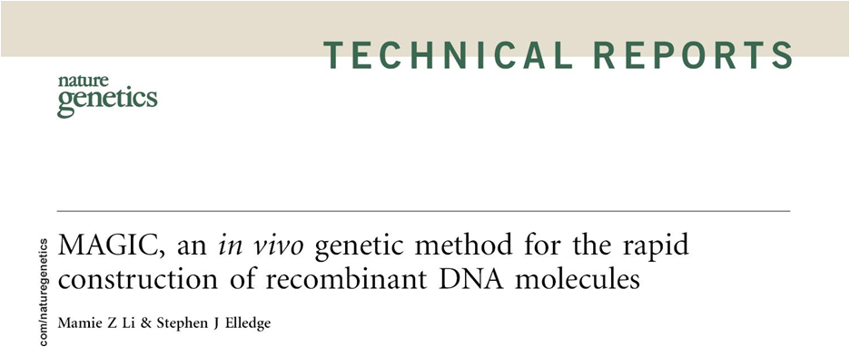
Notes:
In this study, Elledge and coworkers construct strains of E. coli and specialized plasmids that enable the transfer of gene cassettes from one plasmid backbone to another.

Slide 17
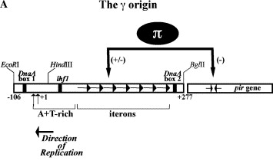
The orthogonal replicon pir/R6K
R6K
R6K
R6K
R6K
pir
wt
pir Strain
Notes:
There are several genetic components introduced into their system, and many of these components are used in diverse settings. First is the R6K/pir conditional origin of replication. R6K is an origin of replication. E. coli is not able to replicate plasmids containing this origin, but if a the cell contains the pir gene, it can be transformed by such plasmids.
*
Pir encodes the protein Pi which binds to short repretive sequences within R6K called iterons which initiate replication. The value of this system is that it is very strict. Without pir, there is no detectable replication of R6K plasmids, but with it the plasmids can be replicated very stably. Additionally, strains such as the DIAL strains have been developed that allow you to tune the concentration of pir in the cell and thus ramp up or down the copy number of the plasmid.

Slide 18
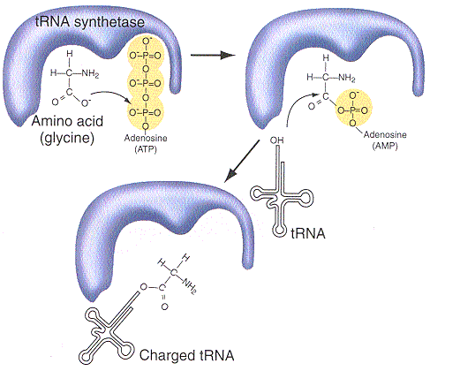
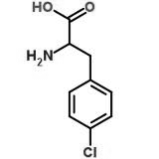
PheS negative selection
p-chlorophenylalanine
Notes:
The second component is PheS negative selection. PheS encodes a mutant of the phenylalanyl-tRNA synthetase. This mutant has relaxed substrate specificity and will accept the unnatural amino acid p-chlorphenylalanine. If you express this enzyme in the cell under normal growth conditions nothing happens – it will continue to charge phenylalanine onto tRNAs, and no phenotype is altered. However, if you feed pheS cells p-chlorophe, it will charge that unnatural amino acid onto phe-tRNAs, and it will get incorporated into proteins. Even a small amount of misincorporation like this will result in cell death, so this gene provides a conditional negative selection: You can selectively kill cells that express PheS while preserving wildtype by growing mixtures of the cells on the unnatural amino acid.

Slide 19
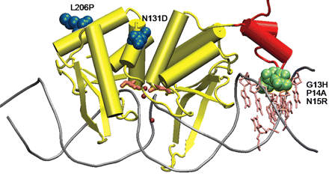

I-SceI Homing Endonuclease
Notes:
The third component is the I-SceI homing endonuclease. This is basically a restriction enzyme, but it recognizes a long and specific sequence. The recognition is sufficiently long and specific that such sites are unique within E. coli. Thus, any DNA that contains this sequence can be specifically cleaved without affecting the viability of the cell.

Slide 20
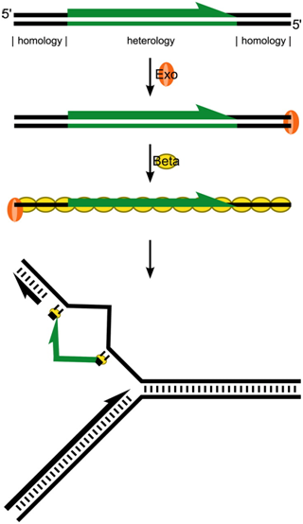
Lambda red recombination
Notes:
The fourth component is lambda red recombination. We’ve seen this system before in the context of MAGE. The device is composed of three genes: Exo Beta and Gam. When a double stranded linear DNA is introduced into cells encoding lambda red, it is highly recombinagenic. The exo function degrades one strand resulting in a single-standed DNA. Beta binds to the single-stranded DNA while Gam modifies normal DNA repair processes. The specifics of the mechanism are not all worked out, but this protein:DNA complex infiltrates the replication fork incorporating the DNA into homologous sequences. Lambda red is the method-of-choice for creating genome knockins and knockouts in E. coli and many other bacteria.

Slide 21
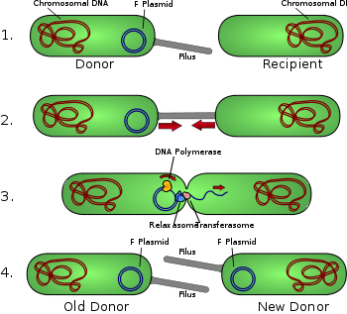
F Plasmid Conjugation
Notes:
The last atypical component is F plasmid conjugation. We discussed F plasmid earlier in the context of biofilm formation, but the more basic function of F plasmid is the transfer of the plasmid from a donor cell to a recipient cell via a pilus. A common trick in these in vivo DNA manipulation systems is to employ a genomically-encoded F plasmid whose origin of transfer has been deleted. The origin of transfer is the site where the conjugation machinery initiates rolling circle amplification and the transfer of the DNA. When you knock it out of the F plasmid genome, the F plasmid is no longer able to transfer. However, if you restore that origin to the system by placing it on another plasmid, the other plasmid will get transferred instead.

Slide 22
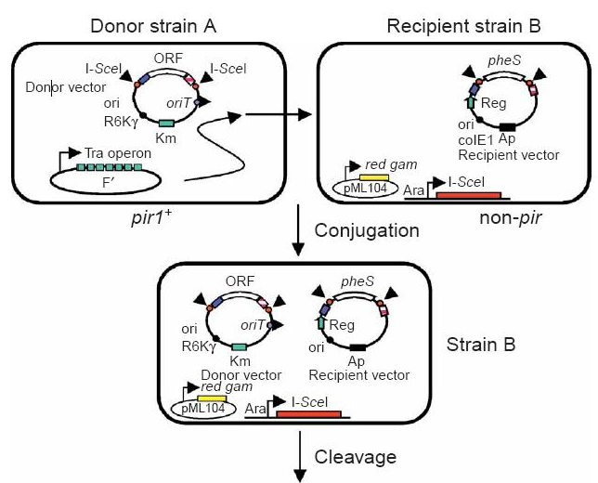
Putting it all together
Notes:
In their study, they put all these components together in a creative way. There are two engineered plasmids in the system: Donor strain A has the donor vector which contains the conditional R6K origin, a KanR gene, the F plasmid origin of transfer, and an arbitrarily chosen gene cassette flanked by I-SceI sites. The goal is to transfer that arbitrary gene cassette into a Recipient vector, which is housed in strain B. That recipient has a normal colE1 origin and amp marker and a a PheS negative selection marker similarly flanked by I-SceI sites. Both strains are stable. The colE1 origin in strain B is sufficient, so as long as you don’t add p-chlorophe and kill the cells they are viable and stable. The strain A cells similarly are stable because they encode the pir gene in their genome. However, when you mix the two cells, MAGIC happens. Strain A contains the F plasmid genes, and the plasmid contains the origin of transfer oriT. Thus, they are F’ cells and produce F pilus and will try to transfer the donor vector to F- cells like strain B. Thus, mixing of the cells results in the transfer of the donor vector into strain B.

Slide 23
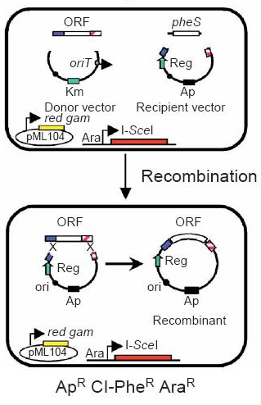
Putting it all together
Notes:
This gets to an intermediary strain containing both plasmids in strain B. Strain B also encodes the I-SceI gene under a Pbad promoter. Thus, addition of arabinose turns on the restriction enzyme resulting in cleavage of the two plasmids to generate double-stranded linear DNAs. Since these cells also encode the lambda red genes, these plasmids are highly recombinagenic towards each other and will recombine. Note that strain B lacks the pir gene, and thus the R6K origin plasmid will not replicated. Outgrowing these cells will therefore eliminate any donor vectors. By growing the cells in the presence of p-Chlorophe, any plasmids that still contain PheS will be eliminated. The result of these selections is that only the recombined plasmid in which pheS has been displaced by the arbitrary gene cassette will survive.

Slide 24
The composition
2 engineered E. coli strains, 2 specialized vectors
A DNA transfer device (F plasmid)
Conditional replication device (R6K/pir)
A recombination device (lambda red)
A selection/counterselection device (lac/bla/pheS)
F plasmid transfers the donor plasmid into the recipient strain
The R6K origin of replication on the donor plasmid, the pir gene in the donor strain, so donor plasmids can’t replicate in recipient cells
The SceI homing endonuclease in the recipient cells to catalyze the linearization of the incoming plasmid
The lambda-red system in the recipient cells to catalyze recombination of linearized, double-stranded DNAs with the recipient plasmid
Positive selectable marker (lacO soaks up lacR allowing a genomic Plac-b-lactamase to activate) and negative counterselection marker (pheS mutant, sensitivity to chlorophenylalanine)
Notes:
To recap, their system is composed of 2 engineered E. coli strains and 2 specialized vectors. It also contains a DNA transfer device, a conditional replication system, a recombination device, and selection systems. When you mix the two strains, F plasmid transfers the donor plasmid but the plasmid is unable to replicate in the recipient host. The homing endonuclease cleaves the DNAs releasing the fragments, and lambda red recombines them. Finally, selections allow only the recombined plasmid to survive. Thus, experimentally, you only need to mix the cells and grow them in some chemicals to functionally transfer the gene cassette into a new vector context. Indeed, this technology turns out to work fairly well and has been used successfully in automated high-throughput experiments.

Slide 25
Payload delivery device
PMID: 23654275
Notes:
How complex can a designer microbiological process be? The early years of research in my lab were focused on this question. It is clear that there are many examples of connecting up sensors and actuators to achieve new function, but how far does this go?

Slide 26
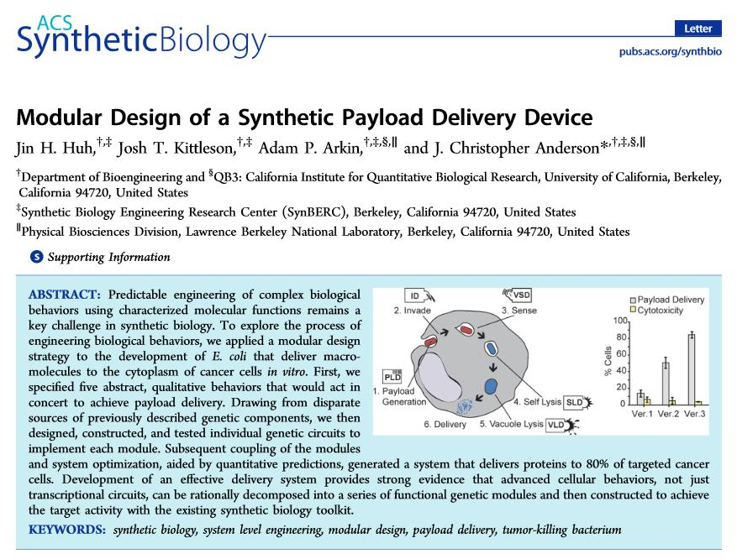
Notes:
In this study, we pushed this style of engineering to its limits in the construction of a payload delivery device.

Slide 27
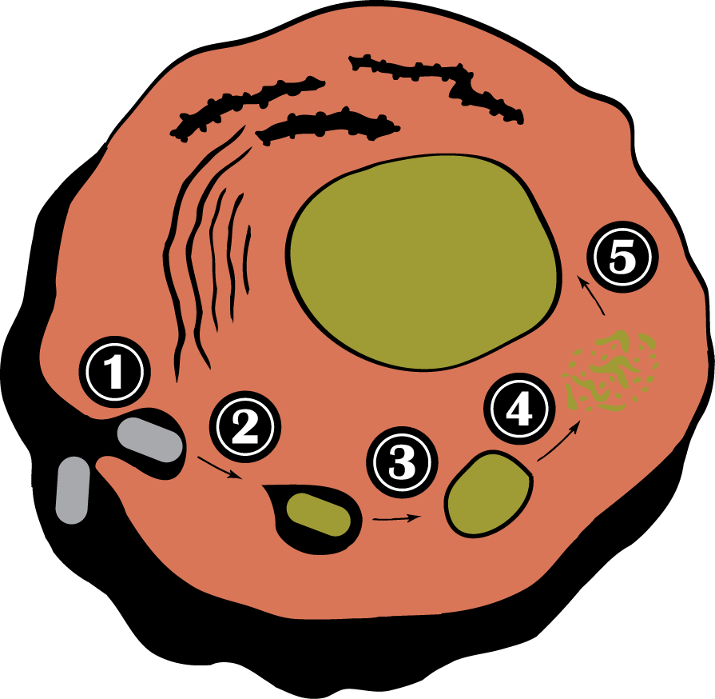
Payload Delivery Device
Notes:
The function of the payload delivery device is to enable E. coli to efficiently invade a cancer cell, sense their encapsulation within a phagocytic vacuole, and activate expression of a delivery program. In response to activation, the bacteria lyse themselves and lyse the vesicle releasing a protein payload to the cells cytoplasm. Simpler routes have been devised that require the acidification of the vesicle by fusion with lysosomes, conditions which can denature the payload. Though engineering, the payload can be delivered under native conditions at much higher efficiency.

Slide 28
The Payload Delivery Device
Vacuole Sensor Device
Self Lysis Device
Vacuole Lysis Device
Effect:
Release contents
Event:
Enter vacuole
Notes:
At the high level, you can separate this device into distinct invasion, delivery, and payload processes. In a previous chapter we discussed the engineering of the invasion process by transcriptional control of the protein invasin. We saw how we could restrict invasion to environmental niches. The payload device is itself a sensor-actuator complex device that is triggered by the chemical microenvironment of the phagocytic vacuole. In response, a self-lysis device and vacuole lysis device are activated, and the payload is released to the cyotplasm.

Slide 29
Substructure Approach
Notes:
To build this system, we constructed individual devices to build and test each component. * We could monitor the activity of vacuole devices by fusing them to GFP, and we could * watch the self-lysis device by controlling it with Pbad. * In principle we could also isolate the vacuole lysis device with Pbad, but there was no microbiological assay to watch that phenotype, and thus this component had to be analyzed in the context of the complete system.

Slide 30
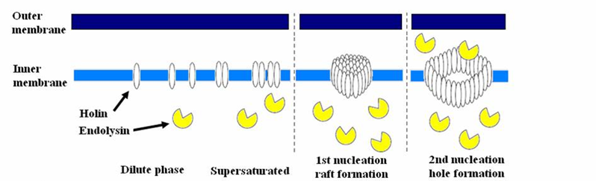
Self-Lysis Device
Notes:
The self-lysis device was composed of three genes from either T4 or lambda phage which encode lysozyme, holin, and antiholin. Lysozyme, when accessible to the periplasm will degrade the peptidoglycan resulting in lysis. However, lysozyme does not contain a periplasmic localization tag. Instead, it gets to the periplasm by leakage through pores caused by holin. Holin is a short peptide that spontaneously inserts into the inner membrane forming holes. The third protein, antiholin, binds to holin and prevents it from entering the membrane. Thus, this system is topologically similar to the threshold-gated circuit. If you try to just express lysozyme and holin, you get an unstable cell. Even low level leaky expression of these genes is sufficient to cause instability and slow growth. However, constitutive expression of antiholin will buffer out low levels of holin production and keep the system off and stable. Upon induction of holin and lysozyme, the antiholin is titrated out and the cells rapidly lyse.

Slide 31
Organism | Protein | Organism | Protein | Organism | Protein
Arcanobacterium pyogenes | pyolysin | Escherichia coli O157 | hemolysin C | Yersinia pseudotuberculosis | hemolysin B
Bacillus cereus | sphingomyelinase | Listeria monocytogenes | Listeriolysin O |  | hemolysin
 | phospholipase C |  | PI-PLC |  | phospholipase A (1)
 | thiol-activated cytolysin |  | PC-PLC |  | phospholipase A (2)
 | hemolysin III | Shigella flexneri | ipaB |  | lysophospholipase L2
 | hemolysin A |  | ipaC | Vibria parahaemolyticus | hemolysin
Clostridium perfringens | perfringolysin O |  | ipaD |  | thermostable hemolysin delta-VPH
 | Phospholipase C |  | ipgC |  | lecithin-dependent hemolysin
Escherichia coli CFT073 | hemolysin A |  | phospholipase A |  | thermostable direct hemolysin A
 | hemolysin C |  | lysophospholipase |  | lysophospholipase L2
 | phospholipase A | Streptococcus pneumoniae | pneumolysin |  | thermostable direct hemolysin S
 | lysophospholipase L2 | Streptococcus pyogenes | streptolysin O | 11 organisms 37 proteins
Escherichia coli O157 | hemolysin A | Yersinia pseudotuberculosis | hemolysin A
Notes:
Many naturally-occuring enzymes are capable of lysing a mammalian membrane. Most of them are able to distinguish animal membrane from bacterial membrane due to the presence of cholesterol. For our studies, we needed to identify ones that were sufficiently specific to animal membranes and would function at physiological pH. By screening 37 proteins from 11 organisms, many of these proteins turned out to be too toxic to express in the cell. However, the phospholipases and streptolysin genes turned out to be sufficiently non-toxic and functional for use.

Slide 32
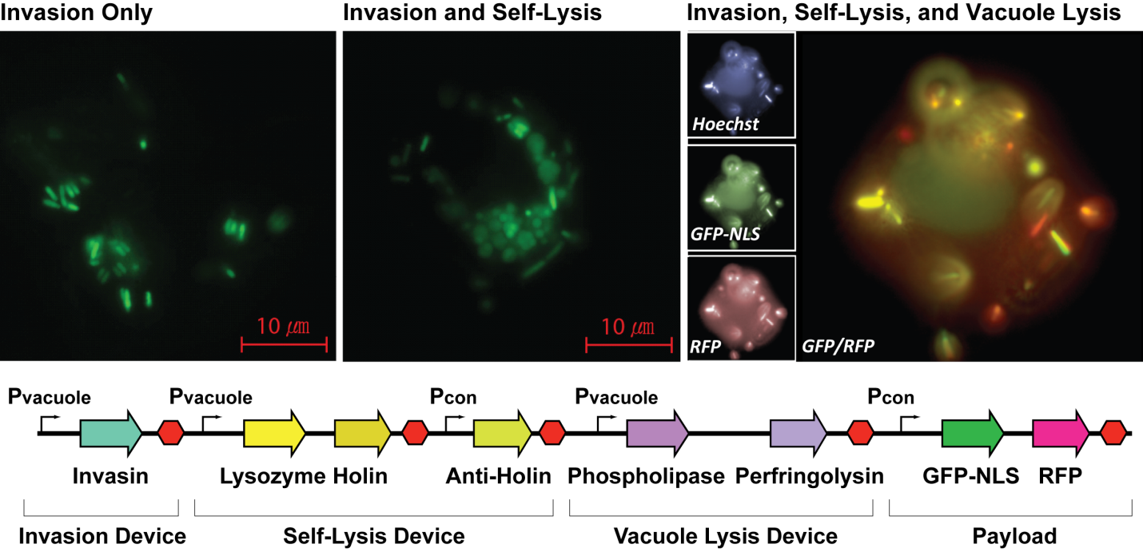
Payload Delivery Device
Pcon
Notes:
The final system works as follows. First, all bacteria encode a payload device composed of two fluorescent proteins. GFP is fused to a nuclear localization signal and RFP is expressed normally. Thus, we can monitor the delivery of these fluorescent proteins to watch the payload delivery process. The invasin gene is encoded constitutively, and if you incubate bacteria enoding just this gene with cancer cells, the bacteria efficiently invade in excess of 90%. If you also add the self-lysis device under the vacuole-induced promoter, the bacteria will round up inside vacuoles in the cell indicating that they have lost their structural integrity. Finally, if you add the vacuole lysis device the vacuoles will burst releasing the proteins to the cytoplasm. The cytoplasmic localization is confirmed by observation of a ‘fried-egg’ phenotype in which the GFP is transported to the nucleus and the RFP fills the entire cytoplasm.

